Slide 1
Lecture 8: Caffe - CPU Optimization
boris. ginzburg@intel.com

Slide 2
Agenda
Profiling of application with Vtune
Caffe with BLAS
Parallelization with OpenMP

Slide 3
Vtune: getting started

Slide 4
Vtune: getting started
get non-commercial license and install Intel Parallel Studio XE 2013: https://software.intel.com/en-us/non-commercial-software-development ( Includes Intel C++ Compiler (icc), Vtune, and MKL )
Buid application as usual (all optimization, but with debug information (-02 -g flag)
Run amplxe-gui
Create vtune project
Run basic Hot-spot analysis
Analyze performance
Exercise: Analyze caffe training using mnist example.

Slide 5
Caffe with BLAS

Slide 6
Caffe with BLAS
Caffe is based on BLAS. CPU:
OpenBLAS: http://www.openblas.net/ - very good open source library
Intel MKL https://software.intel.com/en-us/intel-mkl - even better ☺, closed source , need license
ATLAS http://math-atlas.sourceforge.net/ - slow
GPU:
cuBLAS (part of toolkit): https://developer.nvidia.com/cublas
Basic Linear Algebra Subroutines –set of low-level kernel subroutines for linear algebra:
BLAS1: vector – vector operations;
BLAS2: matrix – vector operations (e.g. “matrix vector multiply” );
BLAS3: matrix – matrix operations (like matrix – matrix multiply).

Slide 7
BLAS: Foundation for Math Computing
BLAS is used as a building block in higher-level math libraries as LINPACK, MKL or PLASMA etc.
Computer Vision
Machine learning
Deep Learning
PARALLEL LINEAR ALGEBRA PACKAGE
BASIC LINEAR ALGEBRA SUBROUTINES
BLAS-1
BLAS-2
BLAS-3

Slide 8
Exercise
Switch between ATLAS, OpenBLAS, and MKL in Makefile.config, compare performance on CIFAR-10
Download new version of OpenBLAS and build it. Compare performance.

Slide 9
openMP

Slide 10
Projects
OpenMP :
an easy, portable and scalable way to parallelize applications for many cores.
Multi-threaded, shared memory model (like pthreads)
a standard API +
omp pragmas are supported by major C/C++ , Fortran compilers (gcc, icc, etc).
A lot of good tutorials on-line:
https://computing.llnl.gov/tutorials/openMP/
http://openmp.org/mp-documents/omp-hands-on-SC08.pdf

Slide 11
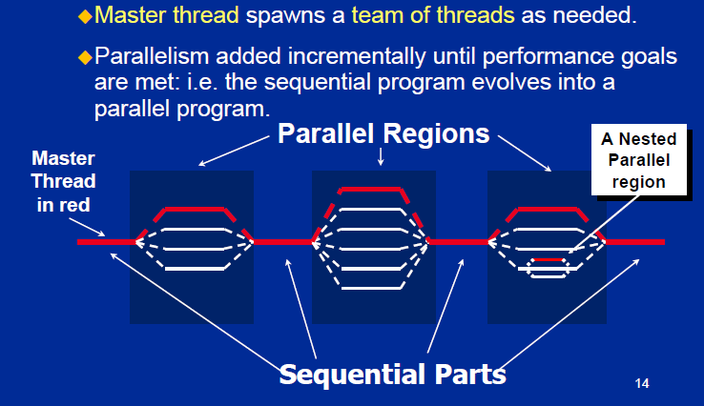
OpenMP programming model
Fork – Join parallelism

Slide 12
Example 1
int main (int argc, char *argv[ ]) {
int i;
float a[N], b[N], c[N];
for (i=0; i < N; i++) {
a[i] = b[i] = 1.0;
}
for (i=0; i<N; i++) {
c[ i ] = a[ i ] + b[ i ]
}
}

Slide 13
Example 1
#include <omp.h>
int main (int argc, char *argv[ ]) {
int i;
float a[N], b[N], c[N];
#pragma omp parallel for
for (i=0; i < N; i++) {
a[i] = b[i] = 1.0;
}
#pragma omp parallel for
for (i=0; i<N; i++) {
c[ i ] = a[ i ] + b[ i ]
}
}

Slide 14
Example 1
#include <omp.h>
#include <stdio.h>
#include <stdlib.h>
#define N 100
int main (int argc, char *argv[ ]) {
int nthreads, tid, i;
float a[N], b[N], c[N];
nthreads = omp_get_num_threads();
printf("Number of threads = %d\n", nthreads);
#pragma omp parallel for
for (i=0; i < N; i++) {
a[i] = b[i] = 1.0;
}

Slide 15
Example 1
#pragma omp parallel for
for (i=0; i<N; i++) {
c[ i ] = a[ i ] + b[ i ];
tid = omp_get_thread_num();
printf("Thread %d: c[%d]= %f\n", tid , i , c[ i ]);
}
}

Slide 16
Compiling, linking etc
You need to add flag –fopenmp to gcc: gcc -fopenmp omp_vecadd.c -o vecadd icc -openmp omp_vecadd.c -o vecadd
Control number of threads through setenv OMP_NUM_THREADS 8

Slide 17
Exercise
Implement:
vector dot-product: c=<x,y>
matrix-matrix multiply,
2D matrix convolution
Add openmp support to relu, and max-pooling layers

